Slide 1
TRAVERSING SERVERLESS ARCHITECTURE
Team No – 4 | CSE-2
MAYANK GUPTA | Priyank gupta | Rajat Upadhyay
Mentor: Dr. kavita sheoran

Slide 2
WHAT IS A SERVER?

Slide 3
THEN WHAT IS SERVERLESS? LET’S TAKE AN EXAMPLE

Slide 4

So, what are servers?
A server is an apple.

Slide 5
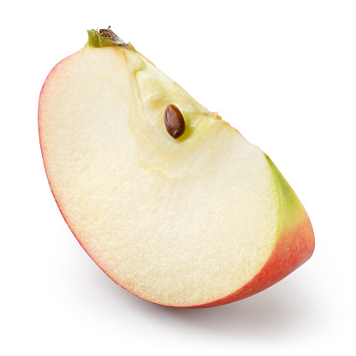
And what is serverless?
Serverless is apple’e pieces

Slide 6
BUT WHY DO WE NEED SERVERLESS AT ALL???

Slide 7
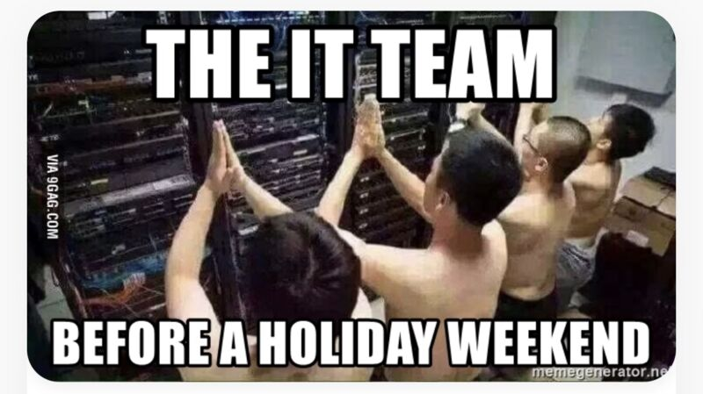

Slide 8
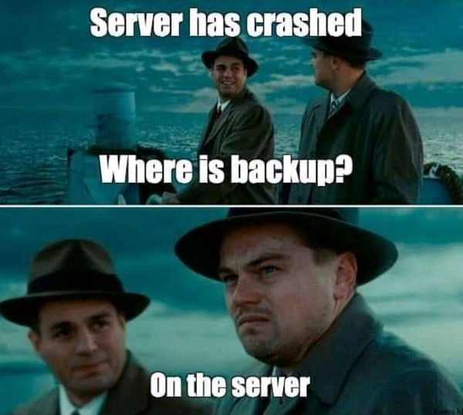

Slide 9
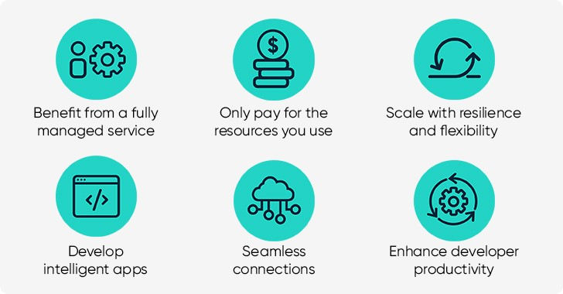

Slide 10
OBJECTIVES
UNDERSTAND SLS INFRA AND IMPLEMENT A SLS PROJECT
COMPARE SLS WITH TRADITIONAL SERVERS ON BASIS OF COST, CODE STRUCTURING, DEPENDENCY ON CODE QUALITY, EVENT DRIVEN PROGRAMMING, ETC.
RESEARCH AND RESOLVE THE PROBLEM OF PERSISTENT STORAGE IN SLS

Slide 11

BUT WHY ARE WE DOING THIS???
SLS IS THE FUTURE FOR SMEs.
CLOUD IS THE NEXT GEN SOLUTION TO ALL PROBLEMS
WE ARE LAZY!! WE DON’T WANT TO WORK WITH SERVERS
SOLVING A VERY IMPORTANT PROBLEM – PERSISTENT STORAGE

Slide 12
WAIT A MINUTE NOW… WE HAVE PROOF.

Slide 13
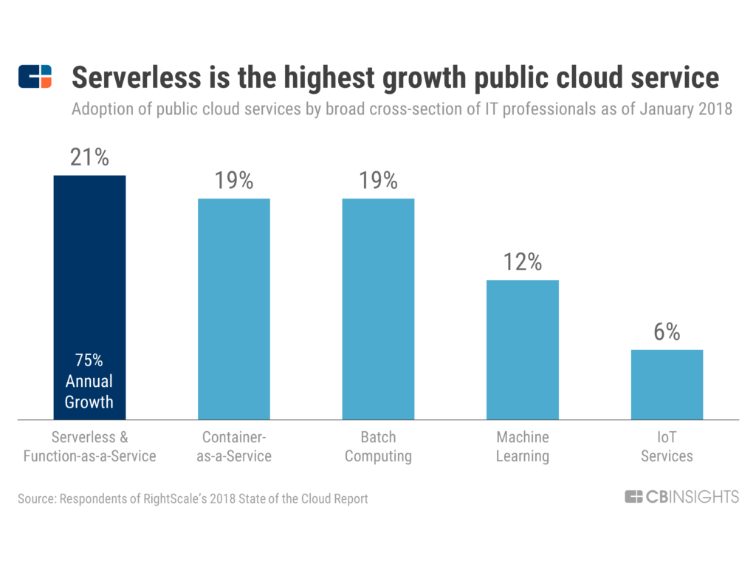

Slide 14
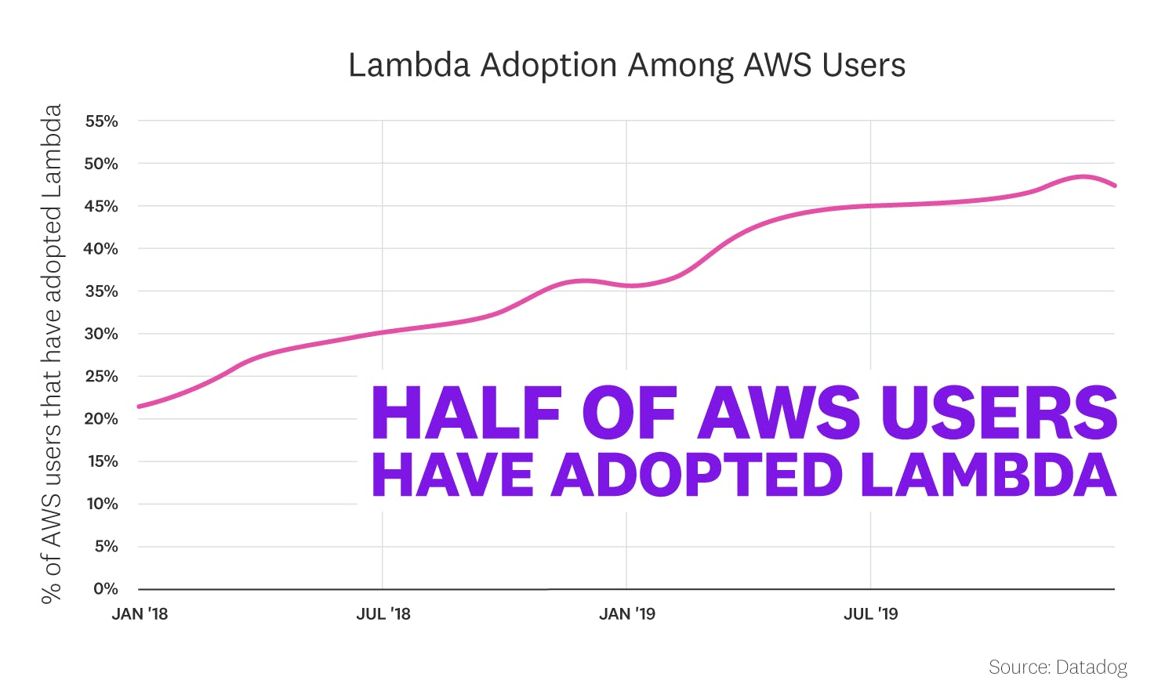

Slide 15
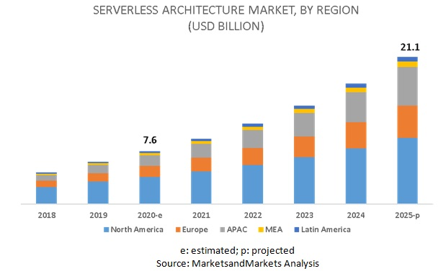

Slide 16
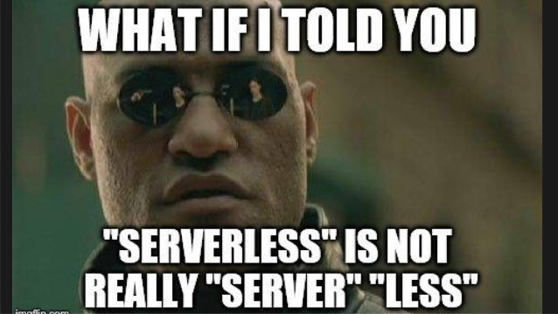

Widescreen Pictures
Pictures can also be presented more dramatically in widescreen.

Slide 17
THANK YOU
IN A WAY, WE ARE ALL SMALL SERVERLESS FUNCTIONS RUNNING AND EXECUTING THE CODE OF OUR OWN LIVES!

